Slide 1
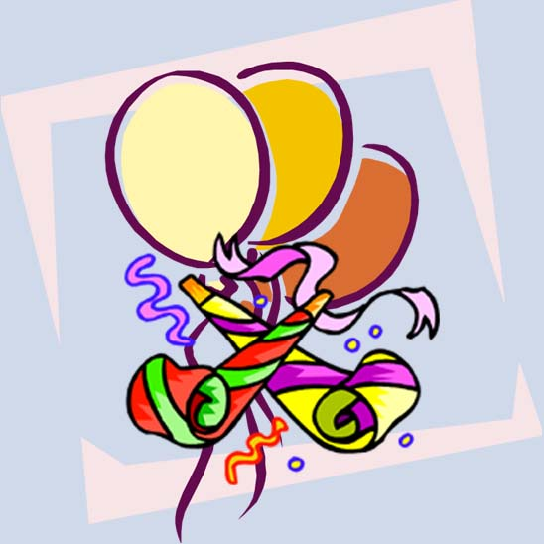
The Present Progressive
5
What’s Happening at the Party?
Focus on Grammar 2
Part V, Units 15 and 16
By Ruth Luman, Gabriele Steiner, and BJ Wells
Copyright © 2006. Pearson Education, Inc. All rights reserved.

Slide 2

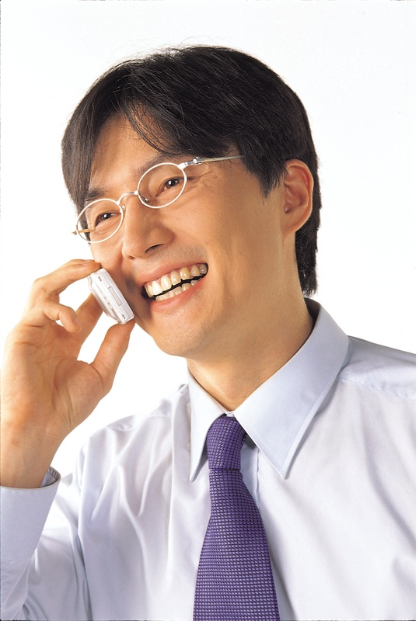
Party Talk
It’s great! I’m sorry you’re missing all the fun.
Hi Jessica. How’s the party?
Me too. What’s happening right now?
Well…
Hi Lee.

Slide 3



Right Now at the Party
Lance karaoke.
is singing
Sam and Joy .
are dancing
Max by himself and fun.
is dancing
having

Slide 4

Form
Present Progressive = Be + Base Form of Verb + -ing
Subject
Be (not)
Base Form of Verb + -ing
Other Words
Carlos
is
opening
gifts.
I
am
wearing
a costume.
Joe and Lina
are
talking.

Slide 5
Use of Present Progressive
Use the present progressive to talk about actions that are or aren’t happening now.
Bob is dancing.
Tina isn’t eating.
Now

Slide 6
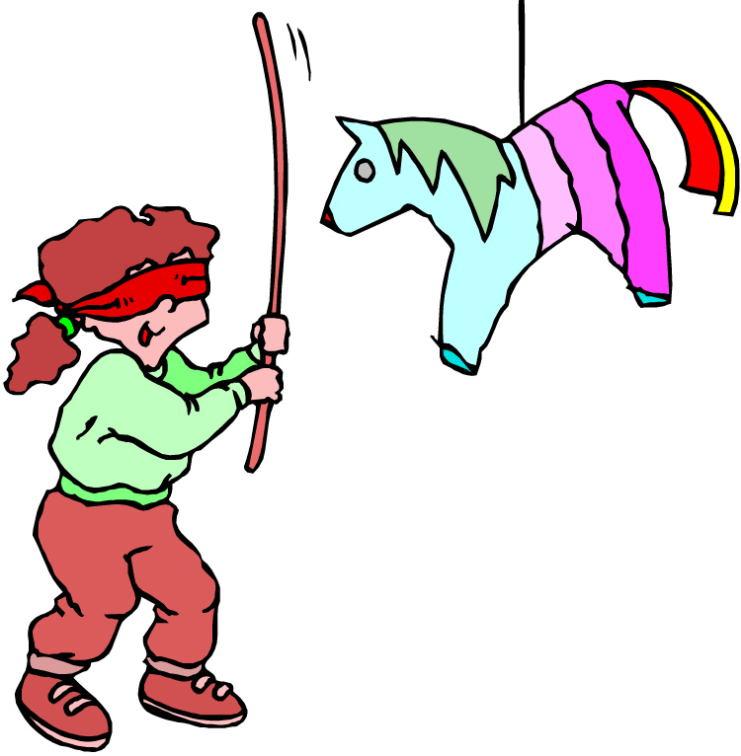
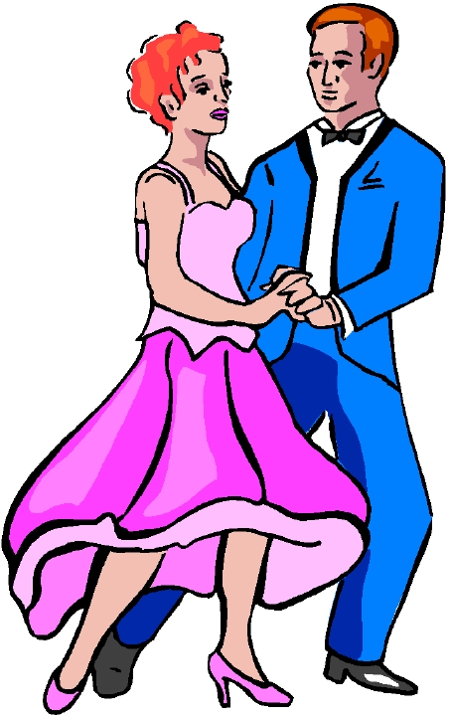
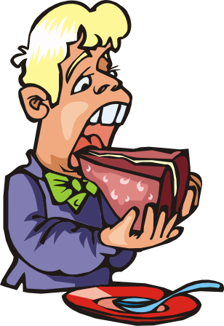
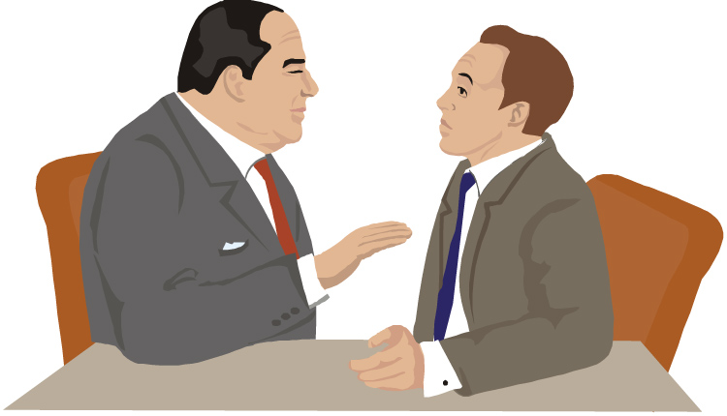
Practice 1
Use the present progressive to describe what is happening now.
Example:
She is hitting a piñata.
1.
2.
3.

Slide 7
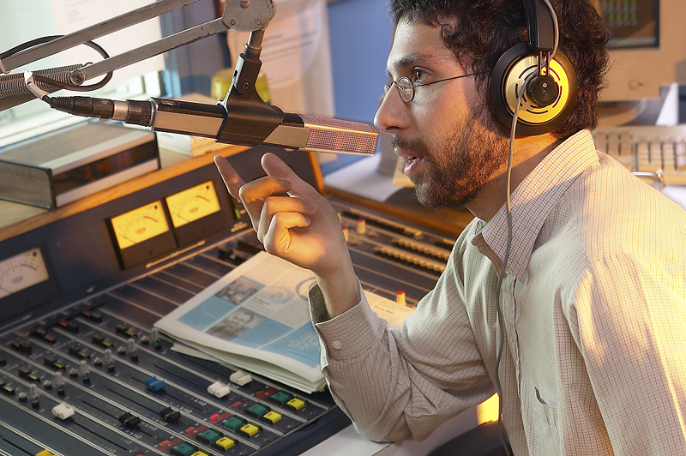
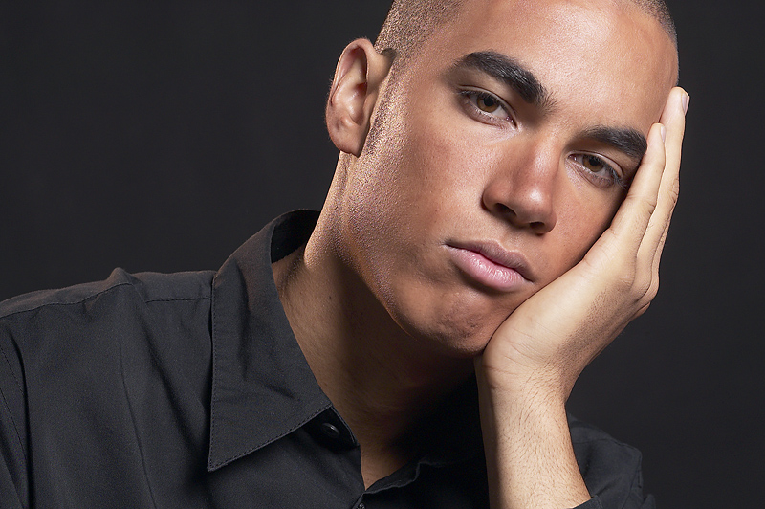
Contractions
Use contractions in speaking and informal writing.
We’re
listening to the DJ.
Dan enjoying the party.
isn’t

Slide 8
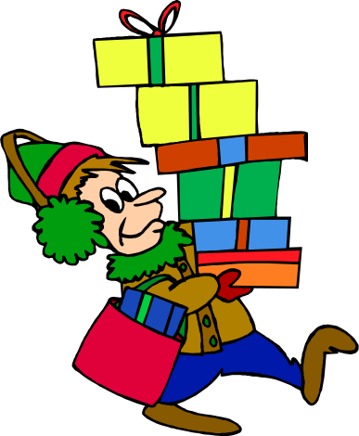
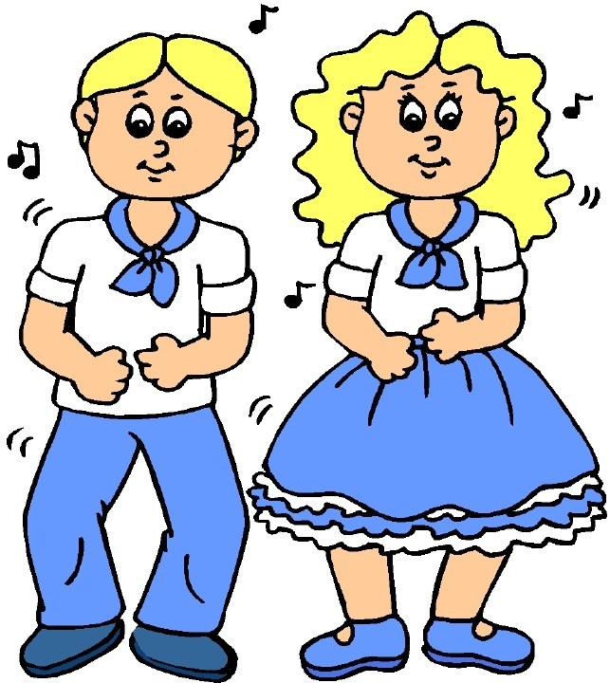
Questions
The verb be goes before the subject in questions.
He
is
.
Is he
bringing gifts
?
dancing
They
are
Are they
?
.

Slide 9
Practice 2
Change the statements to questions.
Example:
He is baking a cake.
He is baking a cake
Is he baking a cake?
1. They are leaving at 9 p.m.
Are they leaving at 9 p.m.?
2. We are wearing costumes to the party.
Are we wearing costumes to the party?
3. Janet is talking about work.
Is Janet talking about work?

Slide 10
Short Answers
We usually use short answers and contractions in speaking, but we can also use long answers.
Are you following my lead?
I’m not following your lead because you’re dancing too slowly!
No, I’m not.

Slide 11

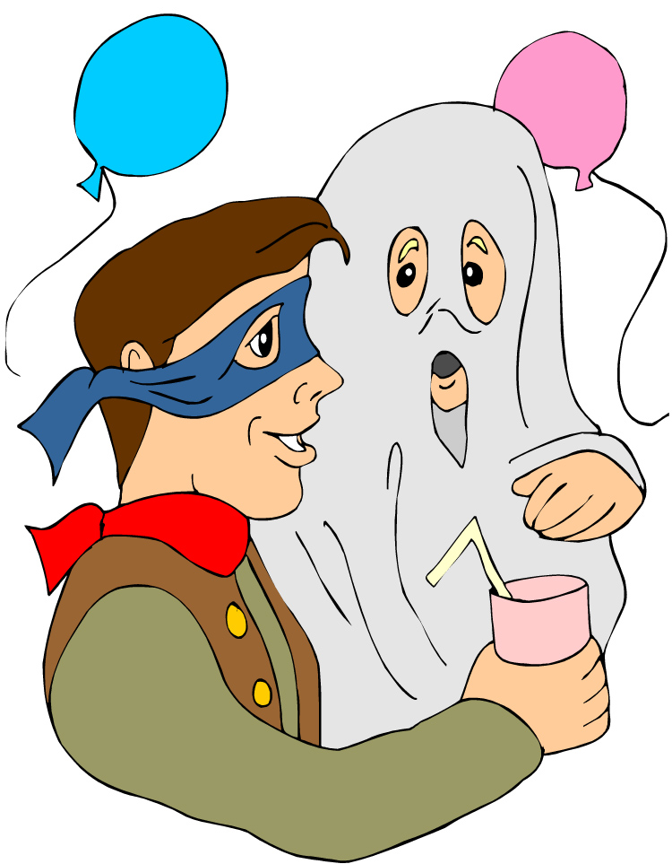
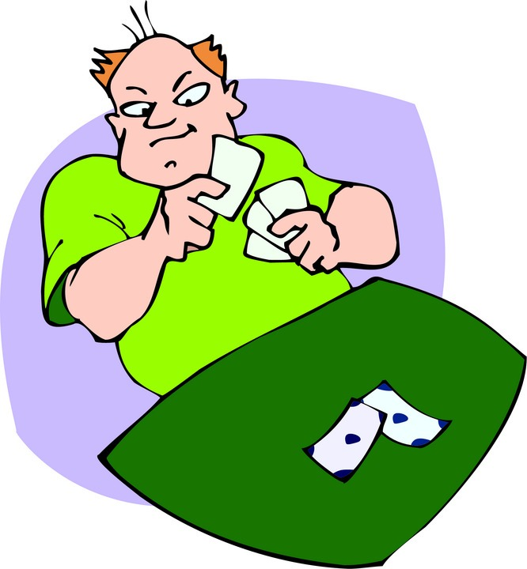
Practice 3
Answer the question about each picture. Use short and long answers with contractions.
Example: Is he pulling out a mouse?
No, he isn’t.
He’s pulling out a rabbit.
1. Is he winning the game?
2. Are they wearing costumes?

Slide 12
References
Copyright © 2006 Pearson Education and its licensors. All rights reserved.

